Slide 1

Training Center Management System
Presented by:
Amr Nawar
Supervisor:
Eng. Wafaa Shehta Ahmed Mentors:
Eng. Islam Elsaify
Eng. Mohamed Ibrahim

Slide 2

PROJECT PLAN
This presentation is dedicated to introducing the 'Training Center Management System' and its key components.
Introduction
Project Overview
Project Objectives
Project Scope
Project Team
Project Timeline
Technical Details
Development Process
Challenges and Solutions
Results and Progress
Future Plans
Conclusion
Questions

Slide 3
INTRODUCTION
The Training Center Management System is essential for :
Efficiency : Streamlining administrative tasks and reducing errors, improving overall operational efficiency.
Informed Decisions: Providing data-driven insights for better planning, resource optimization, and course quality.
User Satisfaction : Ensuring a user-friendly experience for trainers and trainees, enhancing their engagement.
Supervision : Facilitating effective course supervision, maintaining training quality and standards.
Resource Optimization : Efficient resource allocation reduces waste and costs.
Alignment : Aligning with the center's objectives for accurate and efficient training.
Competitive Edge : Offering a competitive advantage in attracting trainees and trainers.
Future Growth : Scalability for accommodating evolving needs and supporting long-term growth and sustainability.

Slide 4






Stages
01
03
04
Back-end
02
Swagger
Front-end
ASP.NET Core
Runtime 7.0
API
Version 16.2.0
Backend
Visual Studio
SCSS

Slide 5
SOFTWARE PROJECT PLAN
Team | Back-End | Front-End | Security
Eng. Islam ElSaify
Eng. Mohamed Ibrahim
Amr Nawar [Me]

Slide 6
PROBLEMS FACED IN THE PROJECT
Data
3/5
Sites
1/5
Personal Info
4/5
Paper Work
5/5
Access
2/5

Slide 7
Trainers & Trainees
Sites
Managing all Objects
View Company’s Sites
Secure Login
Access for administrators
Attendance
Courses
Hilight Atteandace
Enable administrators to view and add courses

Slide 8
TRAINERS & TRAINEES
Search any trainer or trainee by their ID
Check Their Targets and Courses they have accomplished
Add more trainers and trainees

Slide 9
SECURE LOGIN
Only administrators have full access to the website.
100%
30%
Trainers have access to some functions on the website

Slide 10

COURSES
22%
32%
Course 1
Course 2
Mercury is the closest planet to the Sun
Despite being red, Mars is a cold place
12%
34%
Course 3
Course 4
Saturn is a gas giant and has rings
Jupiter is the biggest planet of them all
Administrators view all courses information
They can add more courses and assign every course to specific trainer

Slide 11
Attendance
Work Time
Vacation Time
Rest Time
40%
25%
35%

Slide 12
SITES
Company
One Company
City
In several cities
Sites
Got more than one site

Slide 13
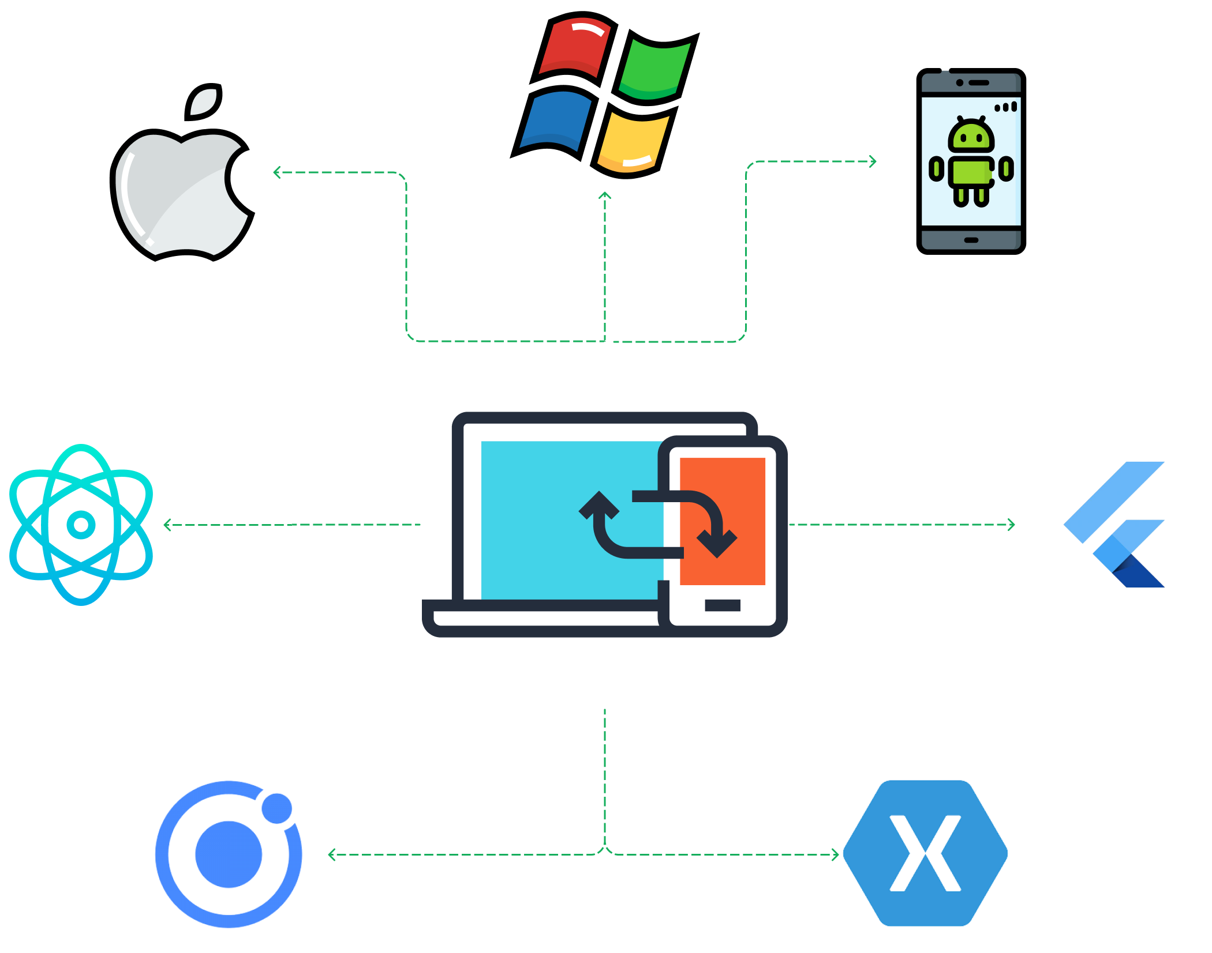
MOBILE
Designed For Two Platforms
DESKTOP

Slide 14
Not All Pages Are Ready
Back-End Ready
Data Base Ready

